Slide 1

NBA game result prediction
Win rate estimation based on previous NBA players’ and coaches’ performance
Team members: Yichen Mu, Fangxu Zhou, Jingxuan Guo, Hao Fu
Notes:
1

Slide 2
Catalog
Team 5 Presentation
^{7/2/21 2}
Introduction
Datatset
Goals & Initial ideas
Unsupervised Learning:
Detection outliers & Find outstanding players
Supervised Learning:
Prediction on outcomes of games
Methods & Results
Future work
Difficulties encountered
Summary

Slide 3
Introduction
Team 5 Presentation
^{7/2/21 3}
Basketball: a popular sport
Machine Learning: a trendy science
Combining together: finds amazing and fun
Course project
Explore what is learnt from CS542 & what is learnt from internet

Slide 4
Dataset
Team 5 Presentation
^{7/2/21 4}
Public
From: http://www.cs.cmu.edu
Only used for CS542 final project

Slide 5
Dataset
Team 5 Presentation
^{7/2/21 5}
Player regular season stats
Player regular season career totals
Player playoff career totals
Team regular season stats
NBA coaching records by season

Slide 6
Dataset: Features
Team 5 Presentation
^{7/2/21 6}
Player regular season stats
Player regular season career totals
Player playoff career totals
Team regular season stats
NBA coaching records by season
Contribution of each player during his each season game, total season career, total playoff carrer
(Pts: points, Dreb: defensive rebounds, etc.)

Slide 7
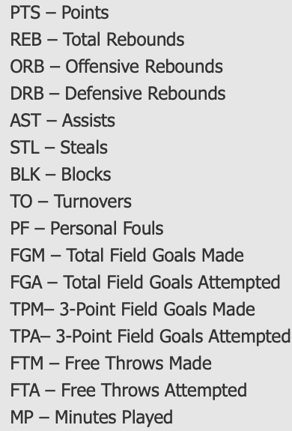
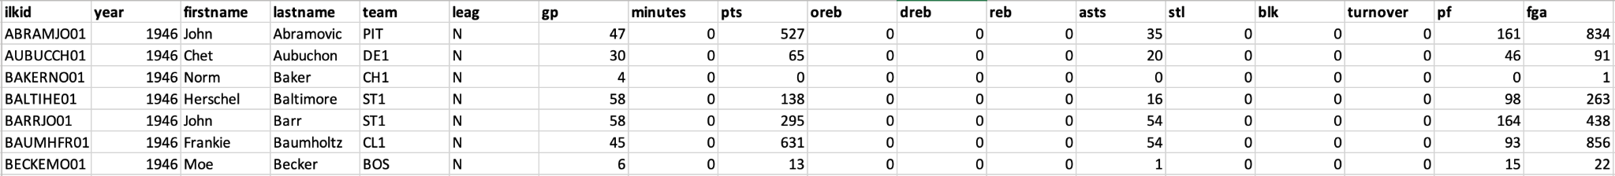
Dataset: Features
Team 5 Presentation
^{7/2/21 7}
Player regular season stats
Player regular season career totals
Player playoff career totals
Team regular season stats
NBA coaching records by season
Contribution of each player during his each season game, total season career, total playoff carrer
(Pts: points, Dreb: defensive rebounds, etc.)

Slide 8
Dataset: Features
Team 5 Presentation
^{7/2/21 8}
Player regular season stats
Player regular season career totals
Player playoff career totals
Team regular season stats
NBA coaching records by season
Contributions of all the players of one team at one season game

Slide 9
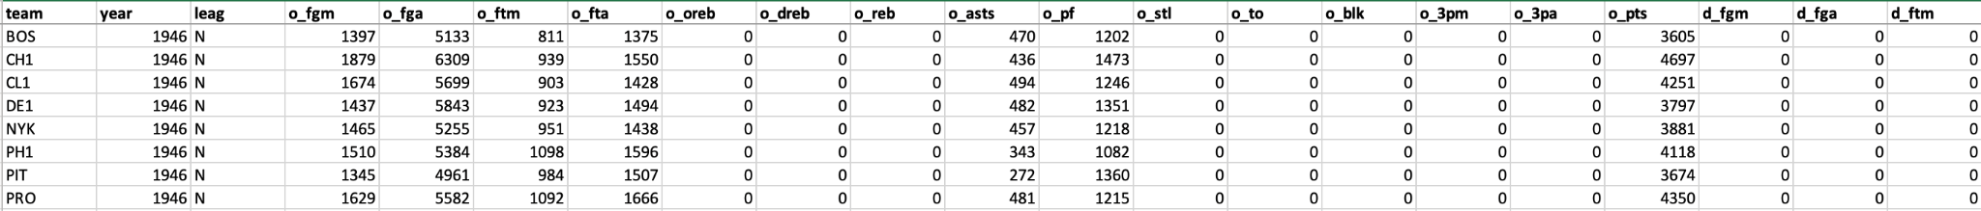
Dataset: Features
Team 5 Presentation
^{7/2/21 9}
Player regular season stats
Player regular season career totals
Player playoff career totals
Team regular season stats
NBA coaching records by season
Contributions of all the players of one team at one season game

Slide 10
Dataset: Features
Team 5 Presentation
^{7/2/21 10}
Player regular season stats
Player regular season career totals
Player playoff career totals
Team regular season stats
NBA coaching records by season
Counts of winning and lossing of a coach of a season game

Slide 11
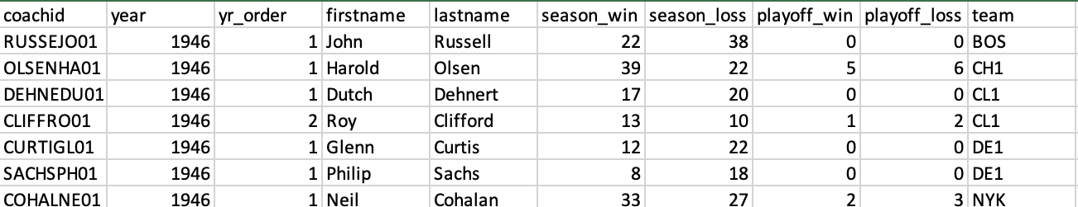
Dataset: Features
Team 5 Presentation
^{7/2/21 11}
Player regular season stats
Player regular season career totals
Player playoff career totals
Team regular season stats
NBA coaching records by season
Counts of winning and lossing of a coach of a season game

Slide 12
Goals & Initial ideas
Team 5 Presentation
^{7/2/21 12}
Explore what we learnt as much as possible
Divide mainly into two parts
Unsupervised learning
Supervised learning

Slide 13
Goals & Initial ideas
Team 5 Presentation
^{7/2/21 13}
Unsupervised learning
With clustering technique to find outliers among players (DBSCAN)
With clustering technique to find outstanding players (Kmeans++)
Supervised learning

Slide 14
Goals & Initial ideas
Team 5 Presentation
^{7/2/21 14}
Unsupervised learning
Supervised learning
Use data of players, coaches and teams of season games from previous years to predict the outcomes of season games of 2003
Using Kmeans++, KNN, SVM, Decision Tree

Slide 15
Methods & Results:
Unsupervised Learning: outliers detection
Team 5 Presentation
^{7/2/21 15}
Cluster the players using features of their contribution of their whole career to detect outliers.
Clean data
Pre-handle data
Reduce dimensions
Cluster
List outliers

Slide 16
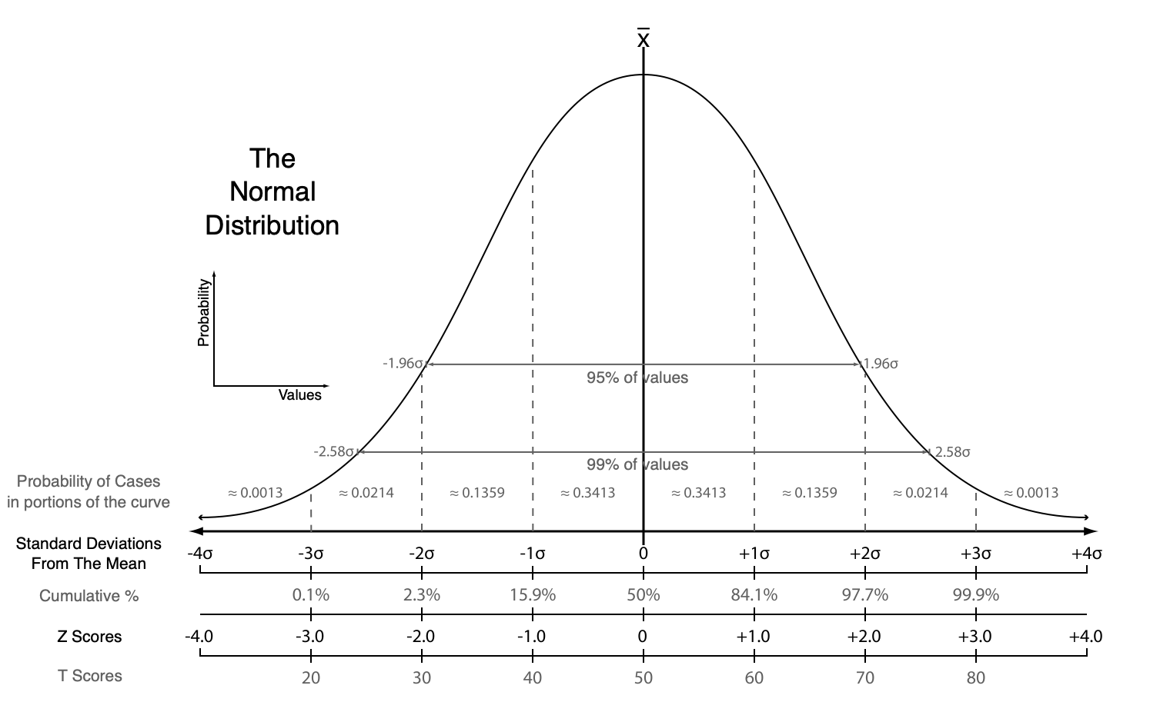
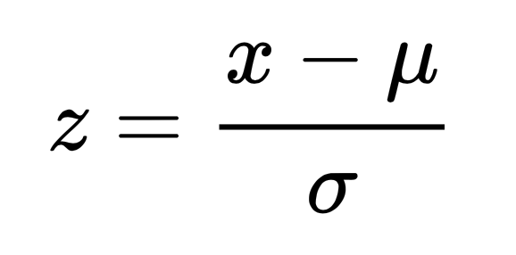
Methods & Results:
Unsupervised Learning: outliers detection
Team 5 Presentation
^{7/2/21 16}
Clean data
Remove players with missing features
Remove unecessary features
List out the players who have 0 as value of the "minutes" feature
Pre-handle data
Divide other features by "minutes"
Normalize: Standard-Score

Slide 17
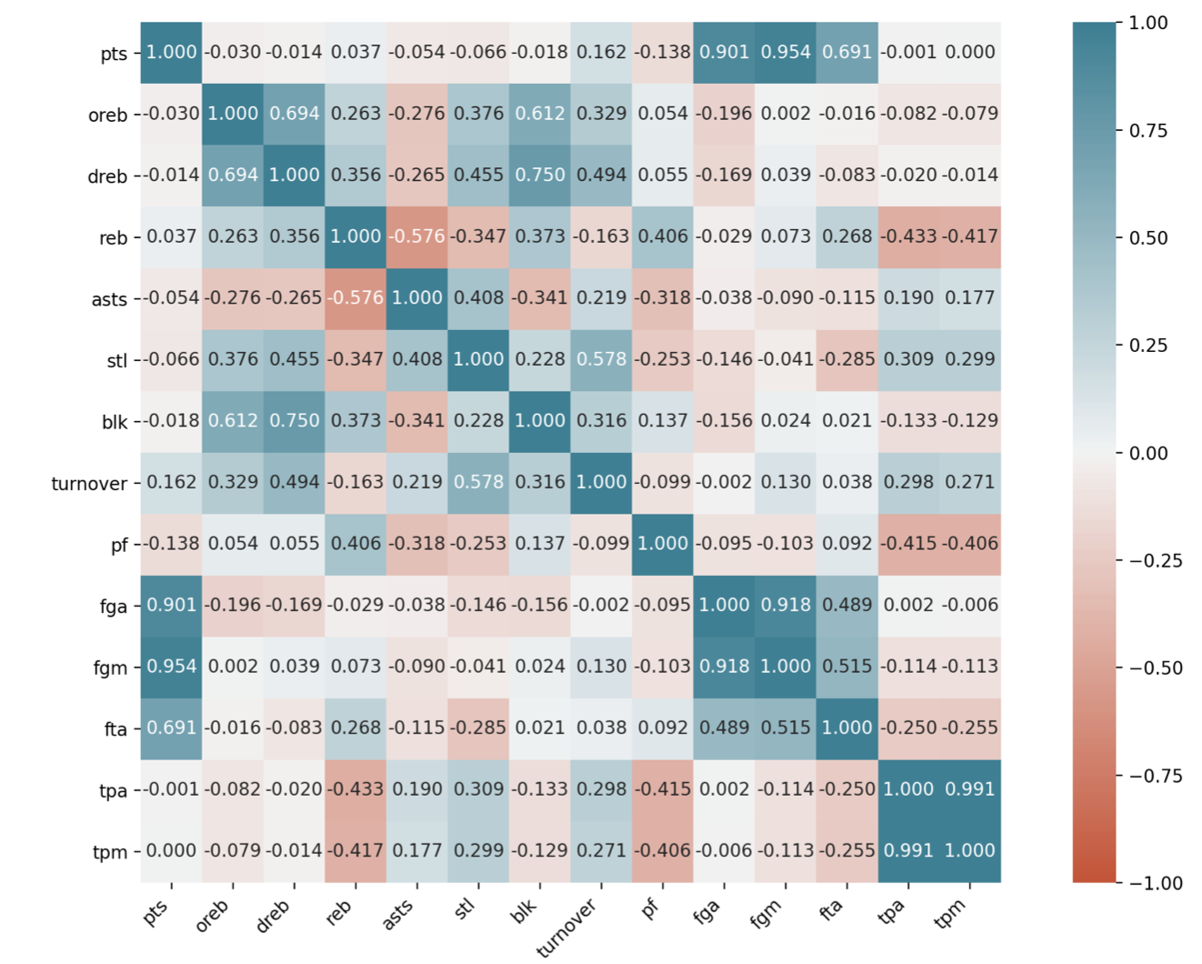
Methods & Results:
Unsupervised Learning: outliers detection
Team 5 Presentation
^{7/2/21 17}
Clean data
Remove players with missing features
Remove unecessary features
List out the players who have 0 as value of the "minutes" feature
Pre-handle data
Divide other features by "minutes"
Normalize: Standard-Score

Slide 18
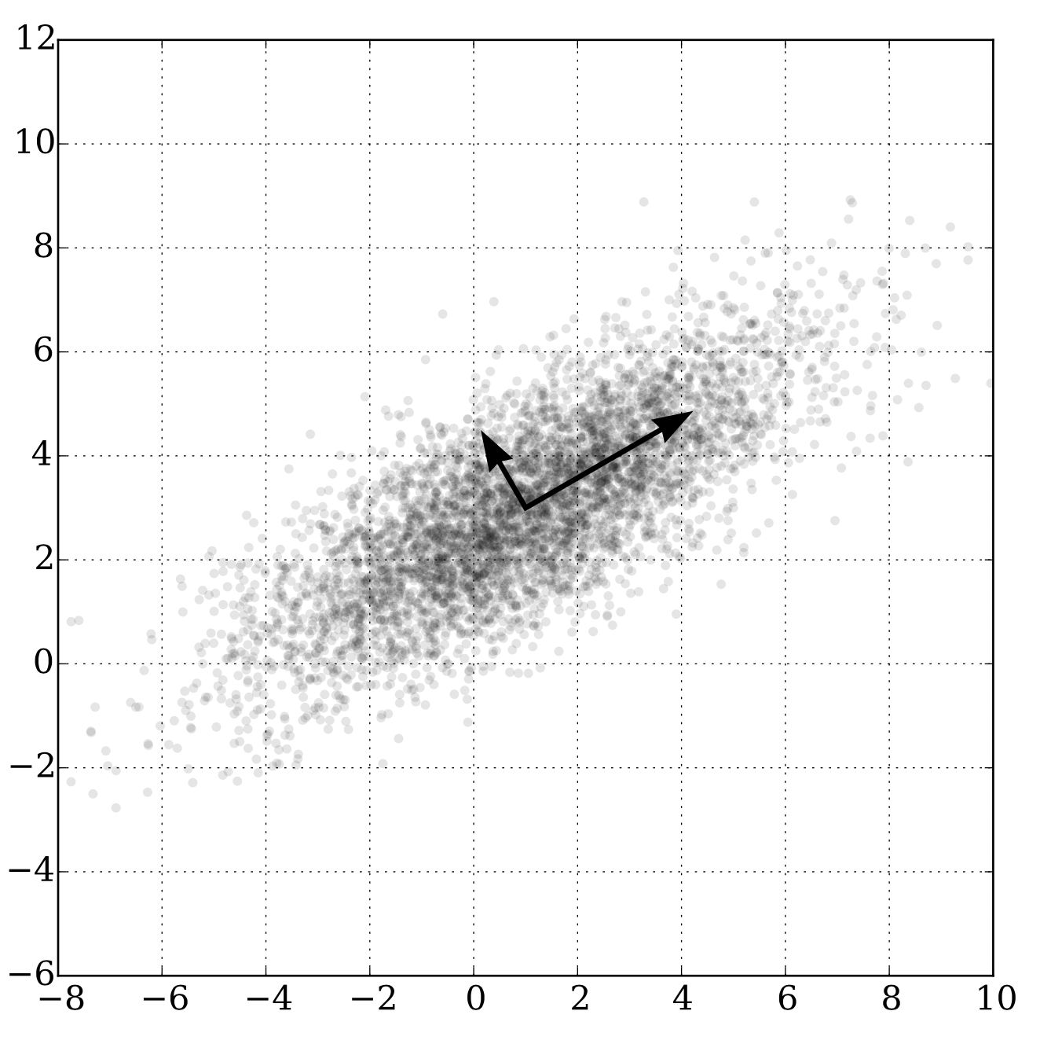
Methods & Results:
Unsupervised Learning: outliers detection
Team 5 Presentation
^{7/2/21 18}
Reduce dimensions: PCA
Project each data point onto only the first few principal components to obtain lower-dimensional data while preserving as much of the data's variation as possible

Slide 19
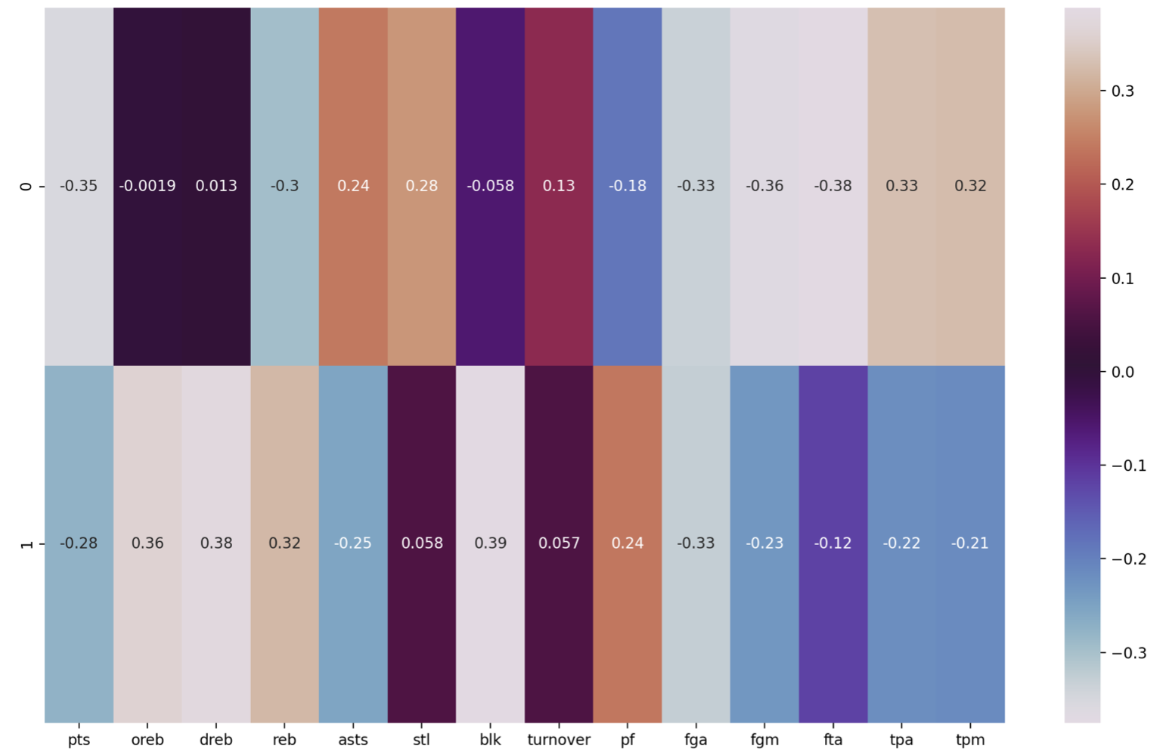
Methods & Results:
Unsupervised Learning: outliers detection
Team 5 Presentation
^{7/2/21 19}
Reduce dimensions: PCA
Project each data point onto only the first few principal components to obtain lower-dimensional data while preserving as much of the data's variation as possible

Slide 20
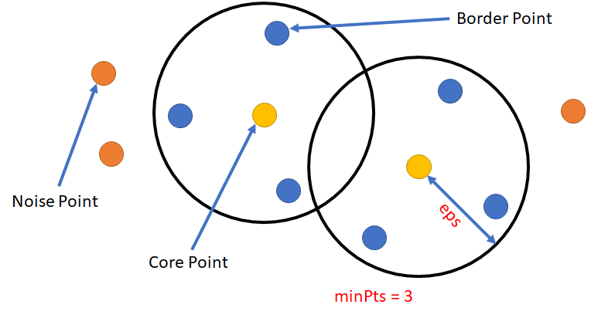
Methods & Results:
Unsupervised Learning: outliers detection
Team 5 Presentation
^{7/2/21 20}
Cluster: DBSCAN
Density-based spatial clustering of applications with noise
No need to pre-decide numbers of clusters
Choice of minPts and ε

Slide 21
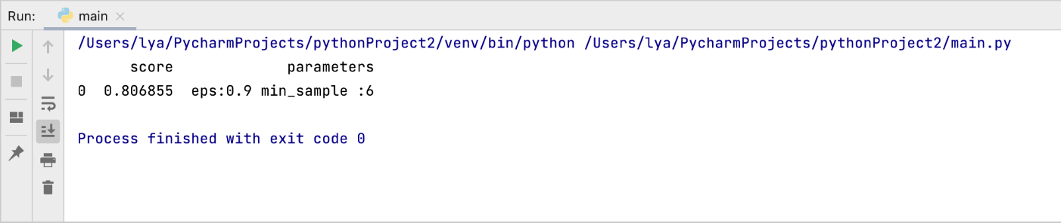
Methods & Results:
Unsupervised Learning: outliers detection
Team 5 Presentation
^{7/2/21 21}
Cluster: DBSCAN
Choice of minPts and ε
Silhouette score

Slide 22
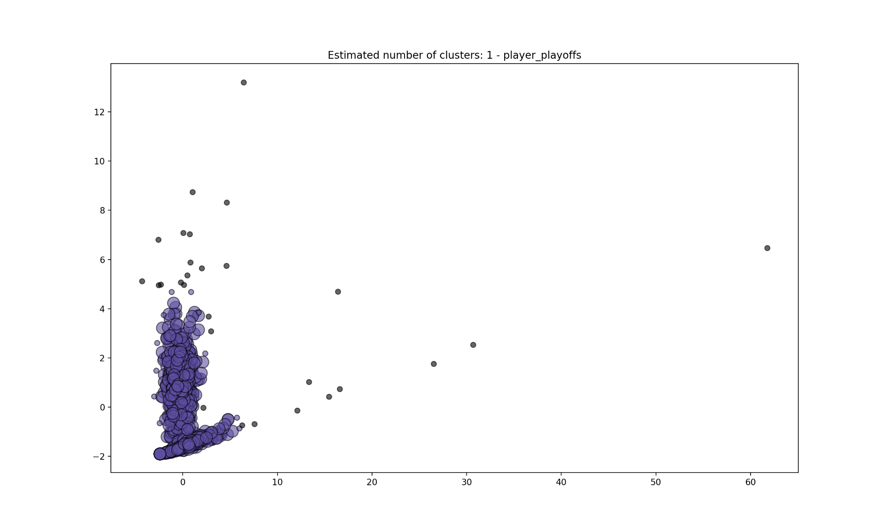
Methods & Results:
Unsupervised Learning: outliers detection
Team 5 Presentation
^{7/2/21 22}
Cluster: DBSCAN
Choice of minPts and ε
Silhouette score

Slide 23
Methods & Results:
Unsupervised Learning: outliers detection
Team 5 Presentation
^{7/2/21 23}
Cluster: DBSCAN
Choice of minPts and ε
Silhouette score

Slide 24
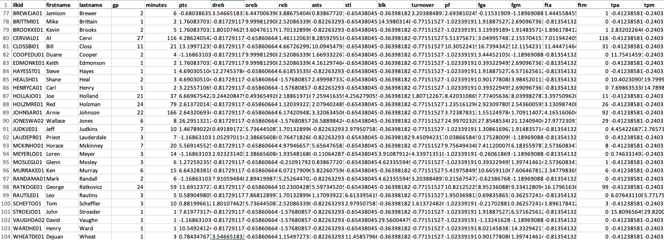
Methods & Results:
Unsupervised Learning: outliers detection
Team 5 Presentation
^{7/2/21 24}
Cluster: DBSCAN
Choice of minPts and ε
Silhouette score

Slide 25
Methods & Results:
Unsupervised Learning: outliers detection
Team 5 Presentation
^{7/2/21 25}
Cluster: DBSCAN
Choice of minPts and ε
Silhouette score

Slide 26
Methods & Results:
Unsupervised Learning: to find outstanding players
Team 5 Presentation
^{7/2/21 26}
Data pre-processing: same as "outliers detection"
Elbow method
Kmeans++

Slide 27
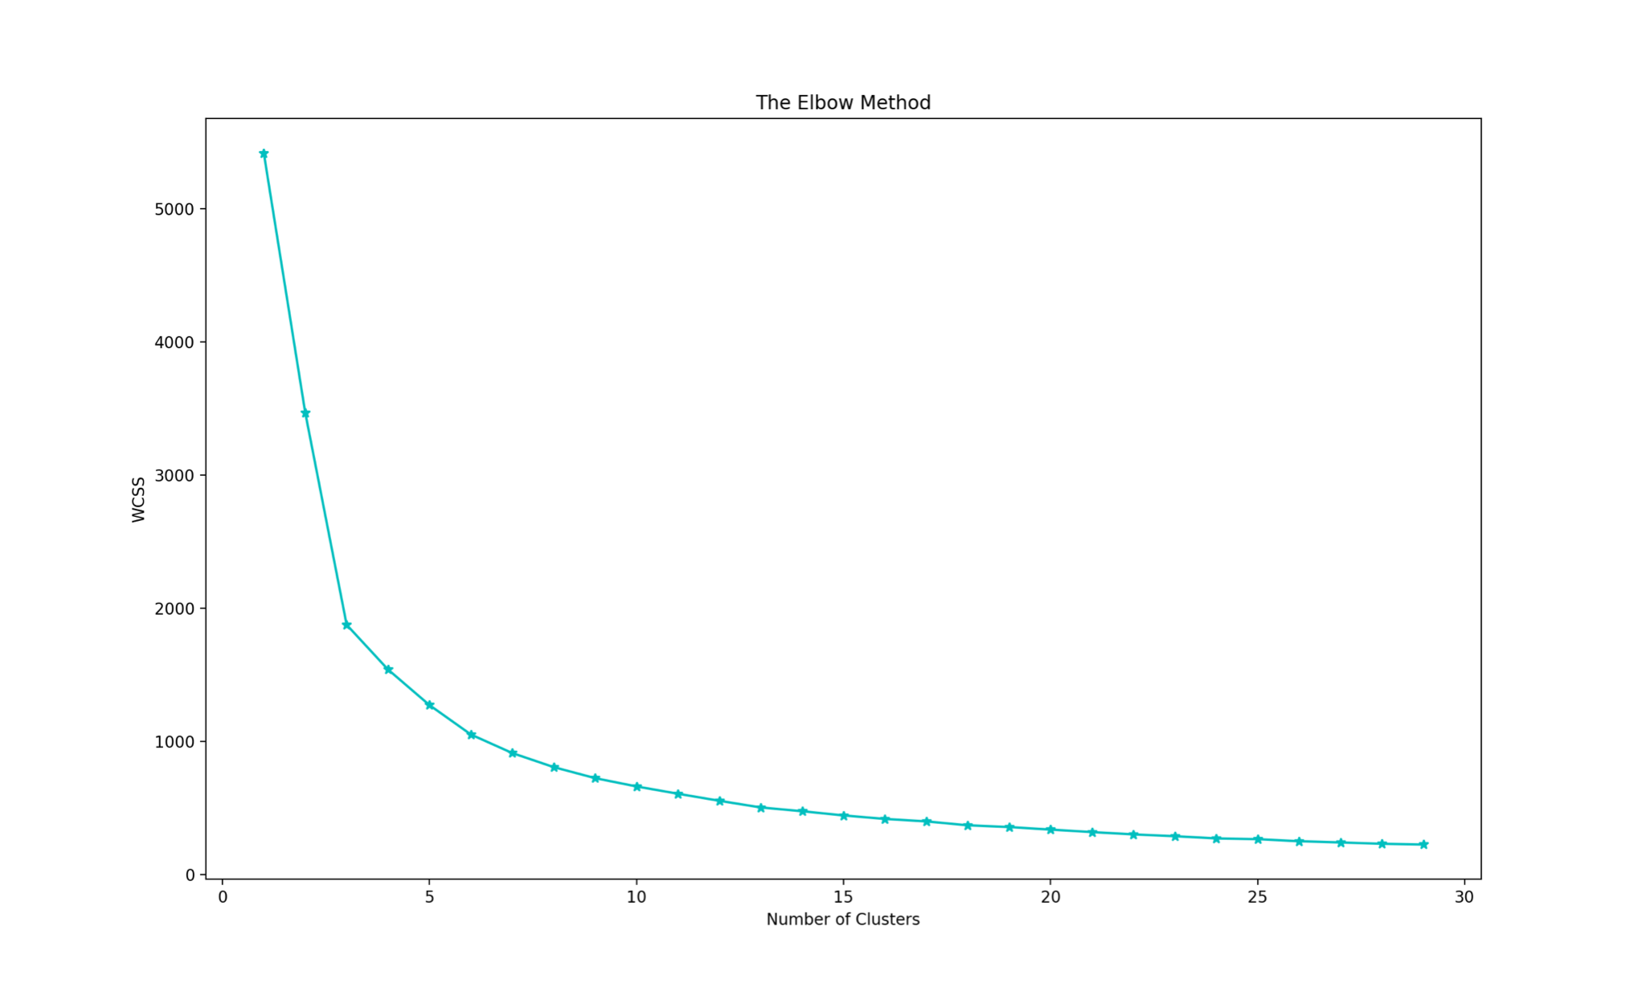
Methods & Results:
Unsupervised Learning: to find outstanding players
Team 5 Presentation
^{7/2/21 27}
Data pre-processing: same as "outliers detection"
Elbow method
Kmeans++

Slide 28
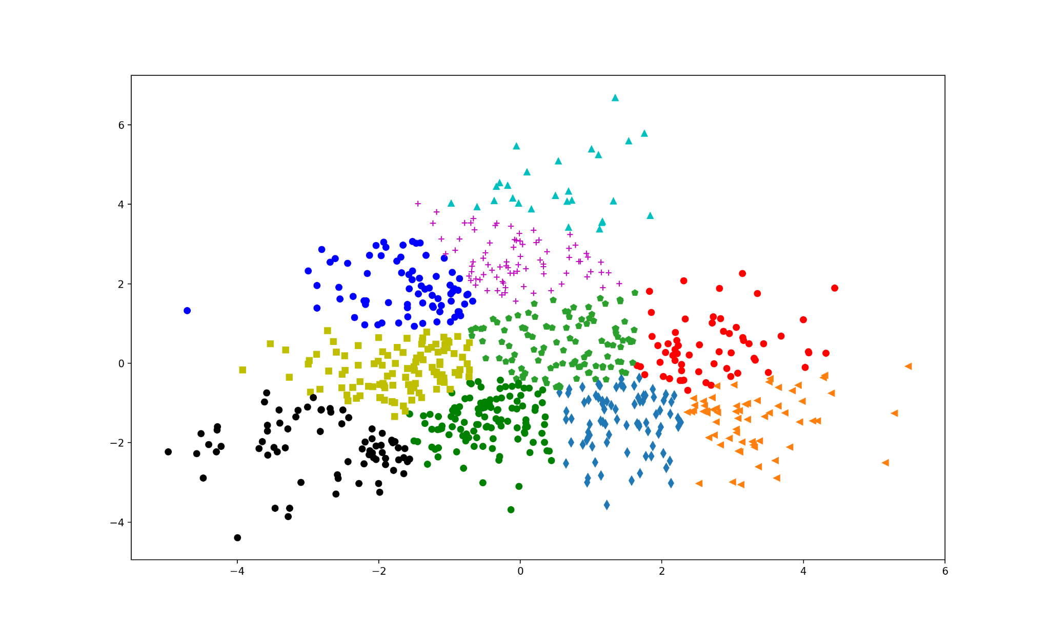
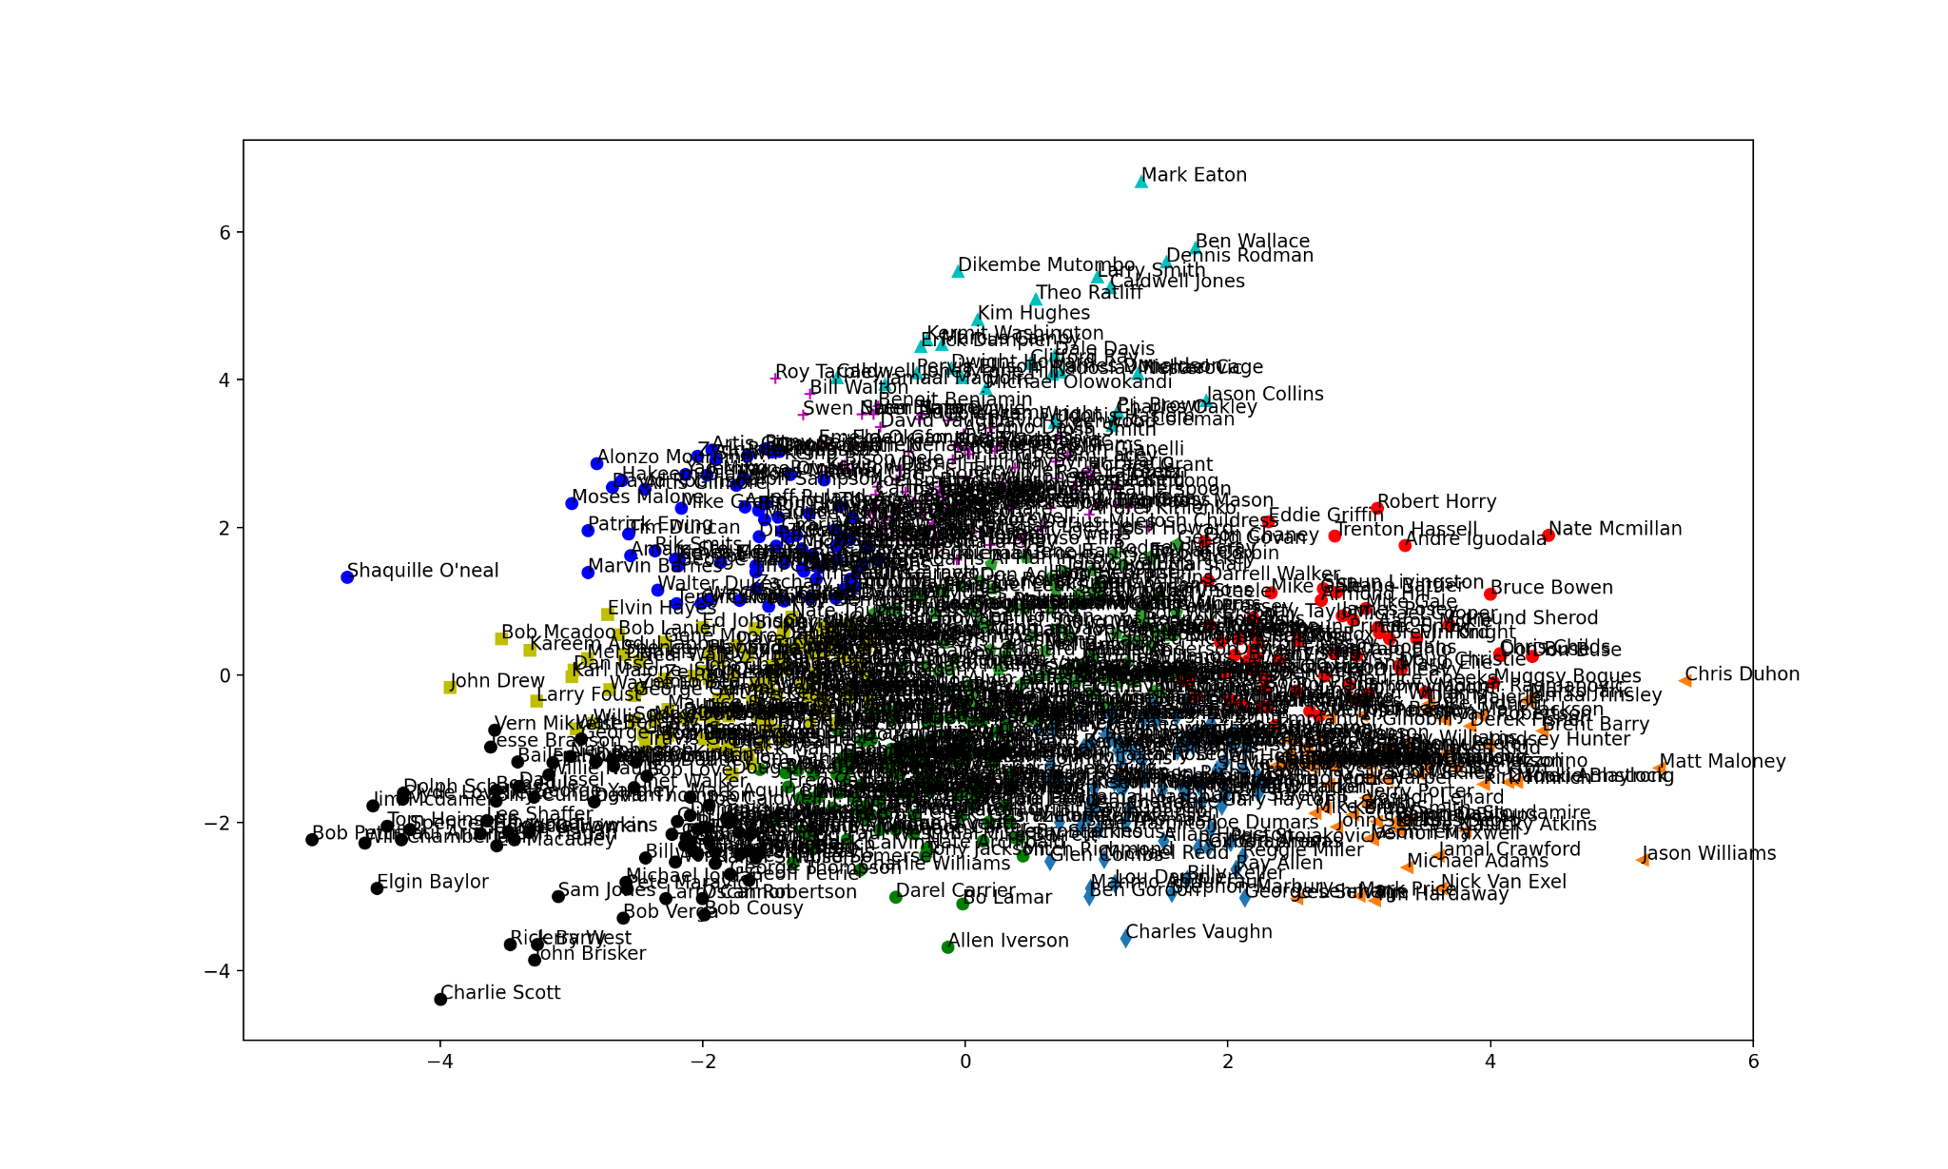
Methods & Results:
Unsupervised Learning: to find outstanding players
Team 5 Presentation
^{7/2/21 28}
Data pre-processing: same as "outliers detection"
Elbow method
Kmeans++

Slide 29
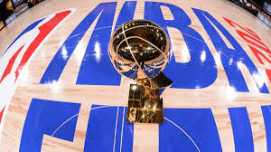
Team 5 Presentation
^{7/2/21 29}
Then, How could we find out the winner?

Slide 30
Preliminary ideas
Team 5 Presentation
^{7/2/21 30}
Many gambling sites have their own methods of forecasting
More recent data
Some inside infomation
Use crawlers to crawl Facebook feeds to assess players' mental states
Our ideas (under the limitation of the dataset)
physical index
Athlete service time
Athlete Career time

Slide 31
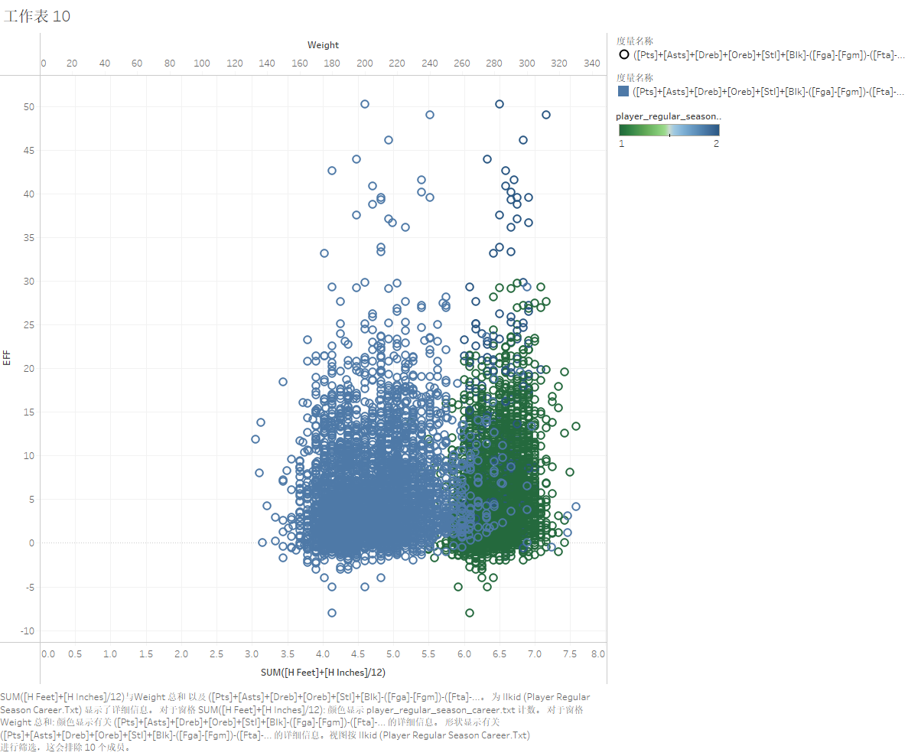
Idea test-physical index
Team 5 Presentation
^{7/2/21 31}
Blue is their weight.(170-270)pound
Green is their height.(5.6-7.1)feed
Could not find out apperant relation between performance and physical index

Slide 32
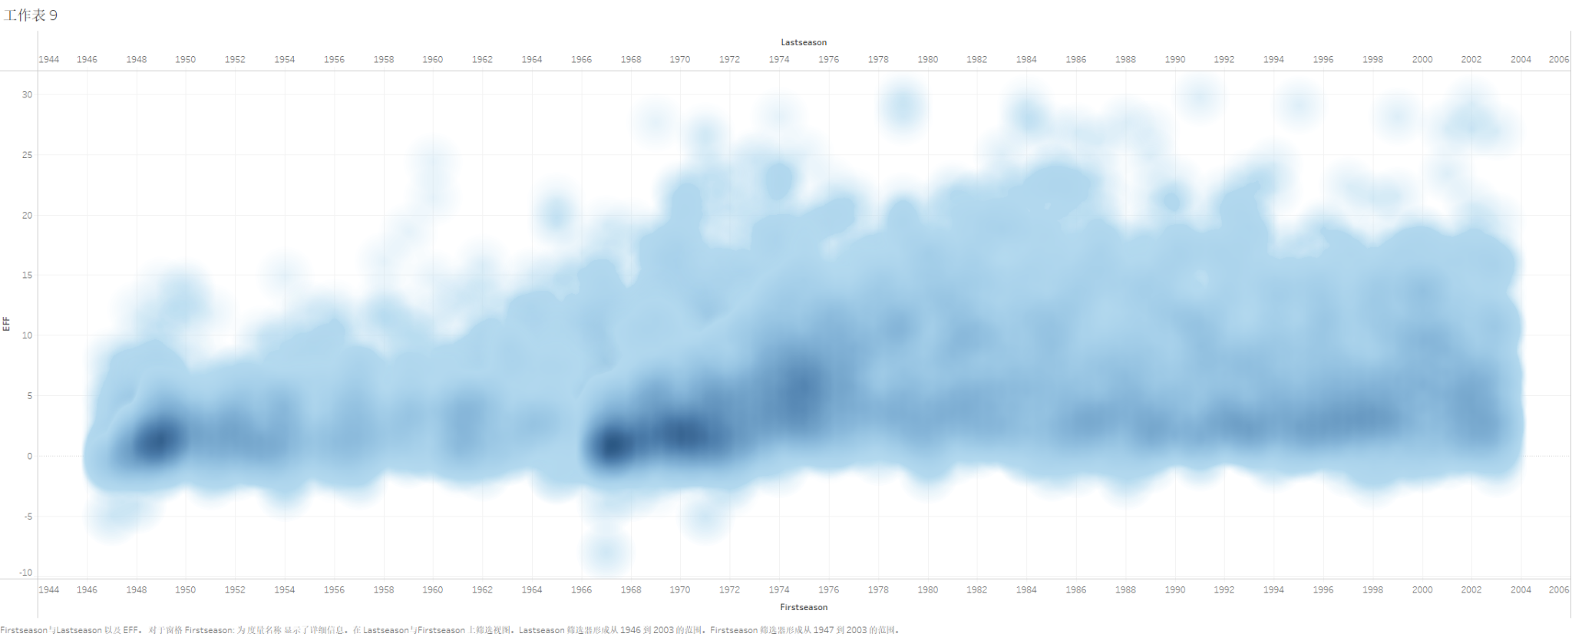
Idea test-Service time
Team 5 Presentation
^{7/2/21 32}
Could not find out apparent relation between performance and service time

Slide 33
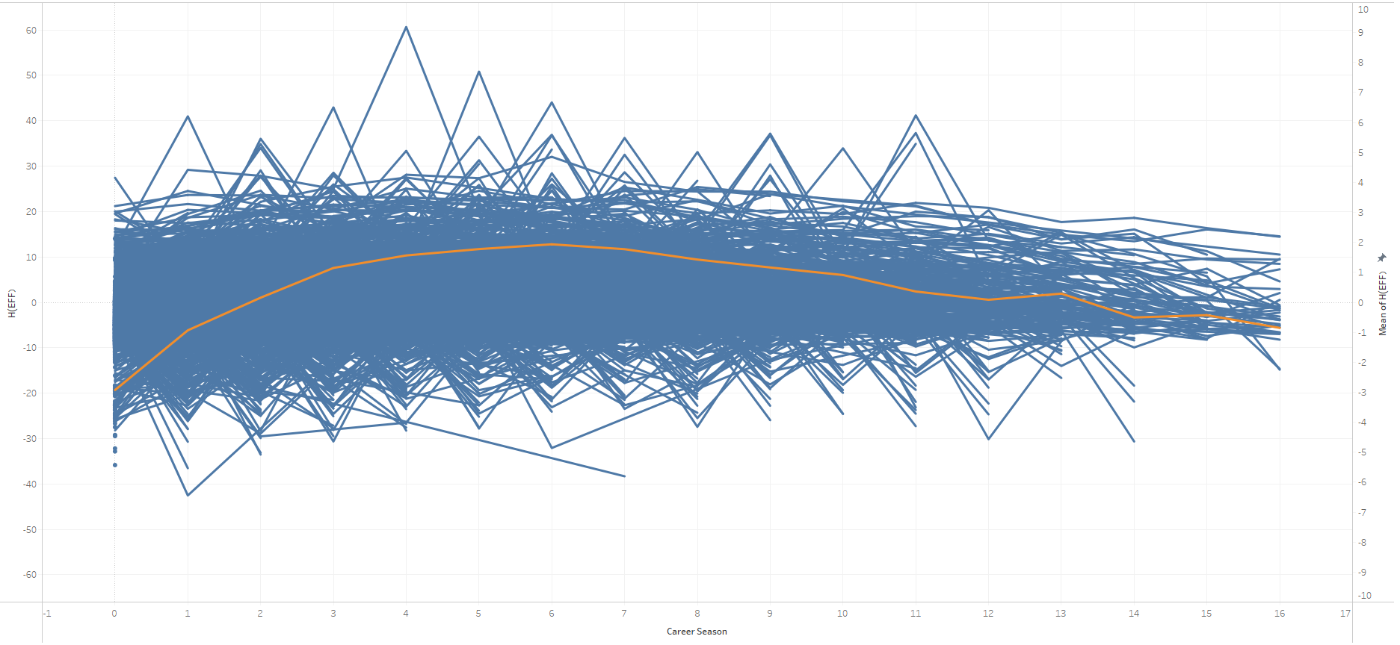
Idea tests-Career time
Team 5 Presentation
^{7/2/21 33}
Each blue lines show the data of the player’s performance minus the average performance of those years.
The orange line shows the expectation of the performance based on Career time.
Their career time may affect their performance.

Slide 34
Methods & Results:
Supervised Learning: prediction of outcomes
Then now in order to know more concrete winning rates for every team, what should we do?
Team 5 Presentation
Overall idea:
We preprocess the data, then use the machine learning algorithms to learn and fit some different models to predict the winning percentage for every team.

Slide 35
Methods & Results: prediction of outcomes
Working process
Team 5 Presentation
^{7/2/21 35}
Data pre-processing
K-means++ clustering algorithm
Supervised learning
Result Comparing

Slide 36
Methods & Results: prediction of outcomes
Team 5 Presentation
^{7/2/21 36}
Data pre-processing: Collect and merge
coaches season
player regular season
team season
Final Data

Slide 37
Methods & Results: prediction of outcomes
Team 5 Presentation
^{7/2/21 37}
Data pre-processing: Filter
Divide the original dataset into two parts
Training data (data before 2003) for later learning.
Testing data (data in 2003) for test.

Slide 38
Methods & Results: prediction of outcomes
Team 5 Presentation
Data pre-processing: Calculate
Create some special representative features
Efficiency of Players and teams: ([Pts]+[Asts]+[Dreb]+[Oreb]+[Stl]+[Blk]-([Fga]-[Fgm])-([Fta]-[Ftm])-[Turnover])/[Gp]
Efficiency of coaches: ([Season_win]*2+[Season_loss]*0)/([Season_win]+[Season_loss])
Rate of Fg: ([Fgm]/[Fga])
Rate of Ft: ([Ftm]/[Fta])
Efficiency of pts: ([pts]/[minutes])
...

Slide 39
Methods & Results: prediction of outcomes
Team 5 Presentation
Data pre-processing: Normalize
After dropping some non-numeric columns, we use the preprocessing.MinMaxScaler()

Slide 40
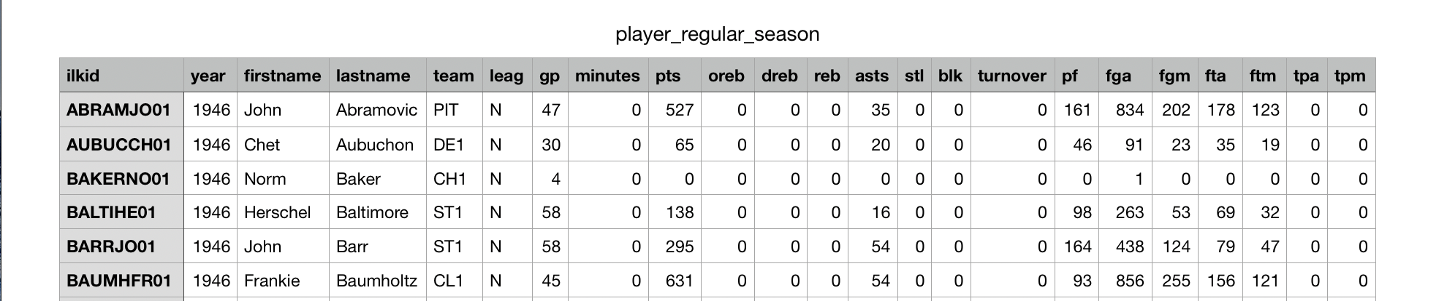
Methods & Results: prediction of outcomes
K-means++ clustering algorithm
Team 5 Presentation
Why do we have to use K-means++ clustering algorithm?

Slide 41
Methods & Results: prediction of outcomes
K-means++ clustering algorithm
Team 5 Presentation
^{7/2/21 41}
Data normalization
preprocessing.MinMaxScaler()
Related material
Elbow function (self-defined)
Create_labels function (self-defined)
Kmeans++ algorithm
matplotlib package

Slide 42
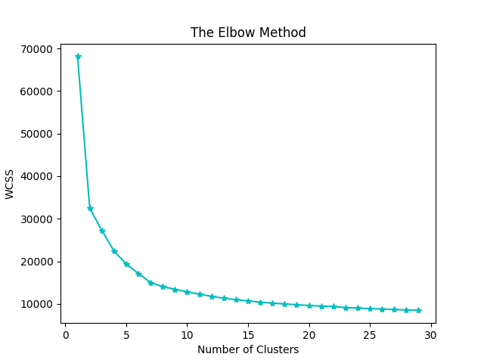
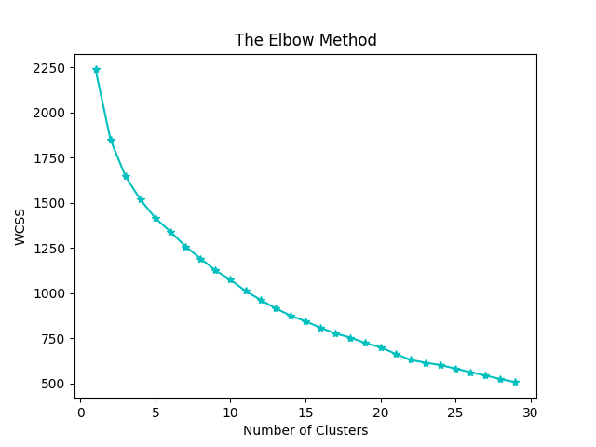
Methods & Results: prediction of outcomes
K-means++ clustering algorithm
Team 5 Presentation
^{7/2/21 42}

Slide 43
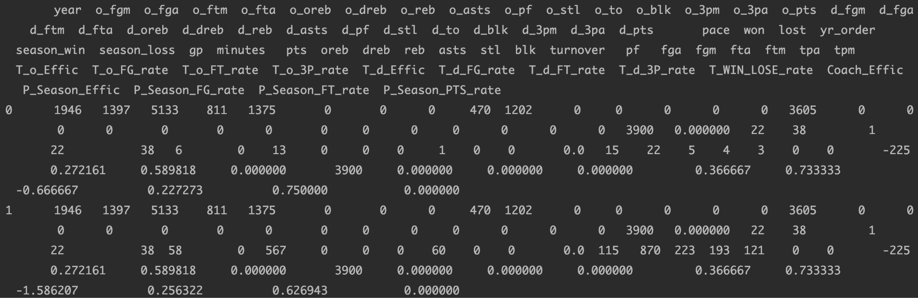
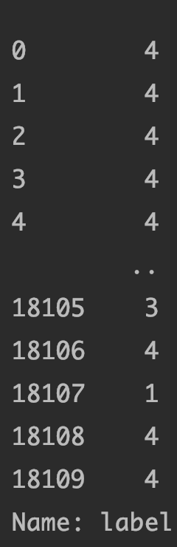
Methods & Results: prediction of outcomes
Added labels Datasets (X_train, Y_train, X_test, Y_test)
Team 5 Presentation

Slide 44
Methods & Results: prediction of outcomes
Supervised learning
Team 5 Presentation
^{7/2/21 44}
Model construction: Makepipeline()
MinMaxScaler()
PCA
Learning algorithms
Learning algorithm
KNN
SVM
Decision Tree
Neural Network

Slide 45
Methods & Results: prediction of outcomes
Selections about parameters
Team 5 Presentation
^{7/2/21 45}
PCA: n_components=0.98, svd_solver='auto'
KNN: n_neighbors=9
Decision Tree:
criterion='entropy',max_depth=None,min_samples_split=2,min_samples_leaf=1,max_features=None,max_leaf_nodes=None,min_impurity_decrease=0
Support Vector Machine: kernel='rbf',class_weight='balanced',C=3.0
Neural Network: solver='sgd',activation='relu',alpha=1e-4,hidden_layer_sizes=(300,300,300),random_state=1,max_iter=200,learning_rate_init=0.001

Slide 46
Methods & Results: prediction of outcomes
Accuracy Results and comparison
Team 5 Presentation
When PCA (n_components=0.98, svd_solver='auto'),
KNN: RMSE on testing set = 1.3280510201777347
Decision Tree: RMSE on testing set = 1.3043080587787235
SVM: RMSE on testing set = 1.86429873038029
Neural Network: RMSE on testing set = 1.115986930599231

Slide 47
Future Work
Team 5 Presentation
^{7/2/21 47}
Finish the result-analysis phase of the unsupervised learning part
Collecting more data to make our dataset more complete.

Slide 48
Diffculties Encountered
Team 5 Presentation
^{7/2/21 48}
Incomplete data
Outdated data
Unfamiliar to Pandas, Numpy and some other python packages

Slide 49
Team 5 Presentation
^{7/2/21 49}
Summary

Slide 50
Team 5 Presentation
^{7/2/21 50}
Thank you!

Slide 51
Resources
Team 5 Presentation
^{7/2/21 51}
https://towardsdatascience.com/which-nba-players-are-most-similar-machine-learning-provides-the-answers-r-project-b903f9b2fe1f
https://ruder.io/semi-supervised/
https://donernesto.github.io/blog/outlier-detection-with-dbscan/
https://per48.co/blog/outliers_nba/
https://nikkimarinsek.com/blog/7-ways-to-label-a-cluster-plot-python

Slide 52
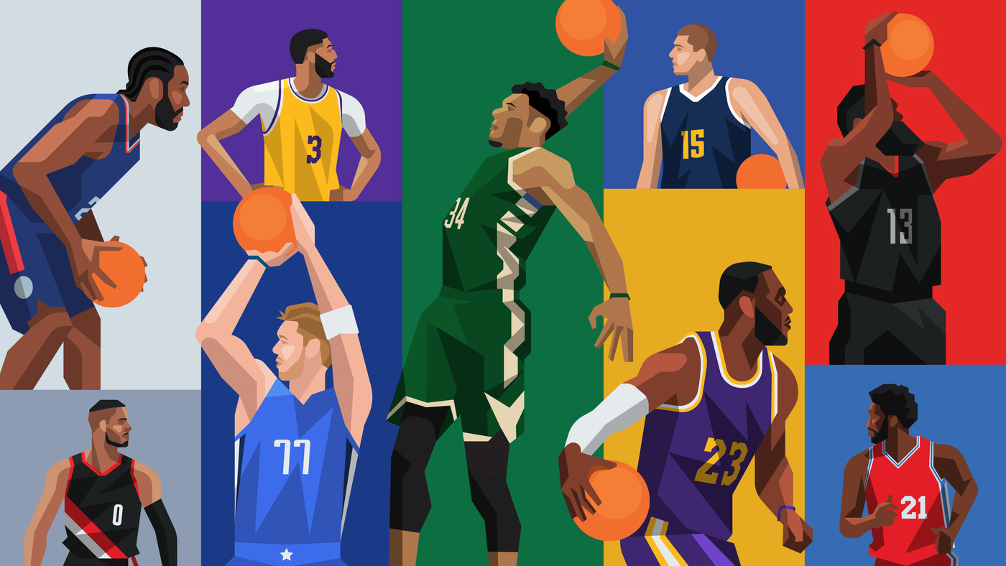
Team 5 Presentation
^{7/2/21 52}
Q&A

